Slide 1
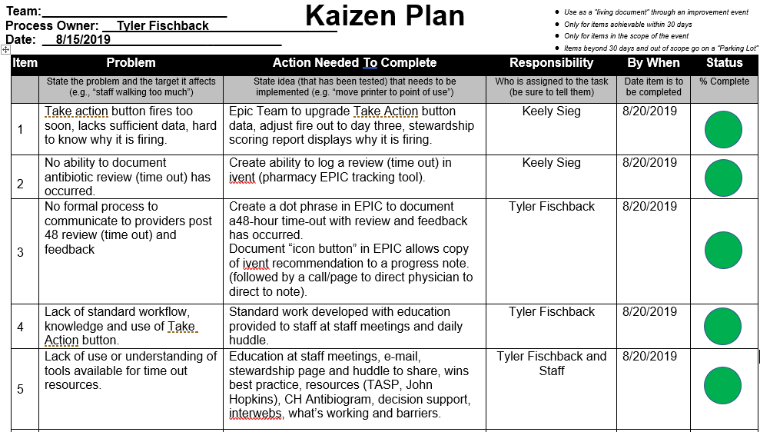
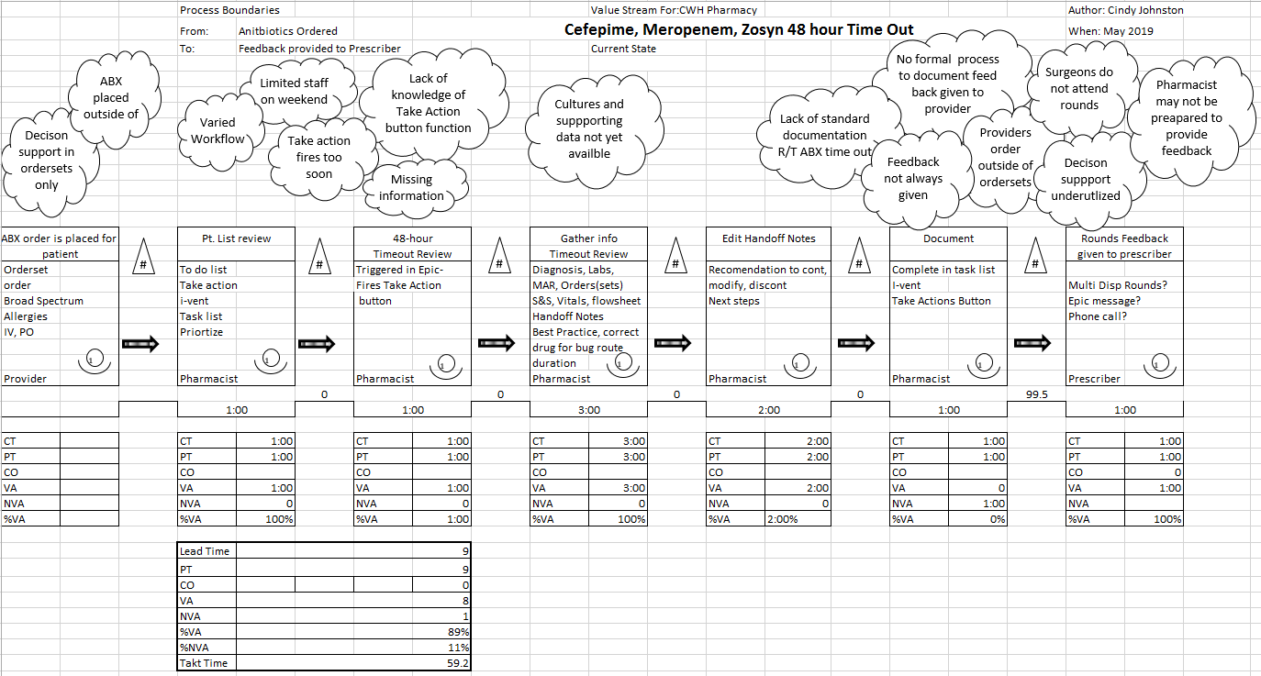
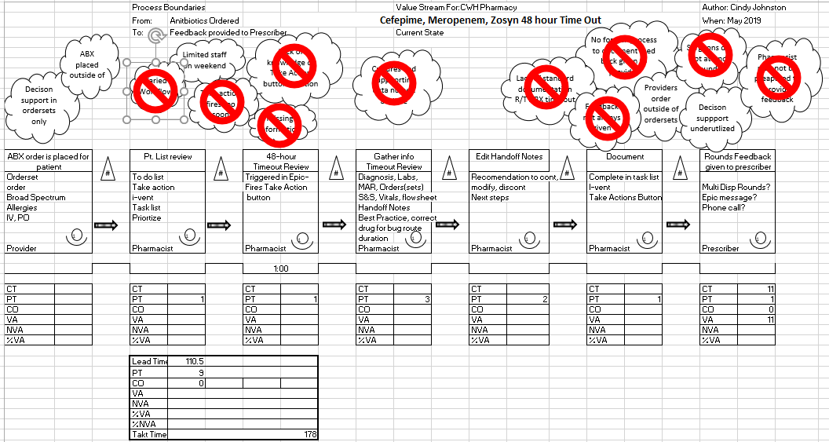
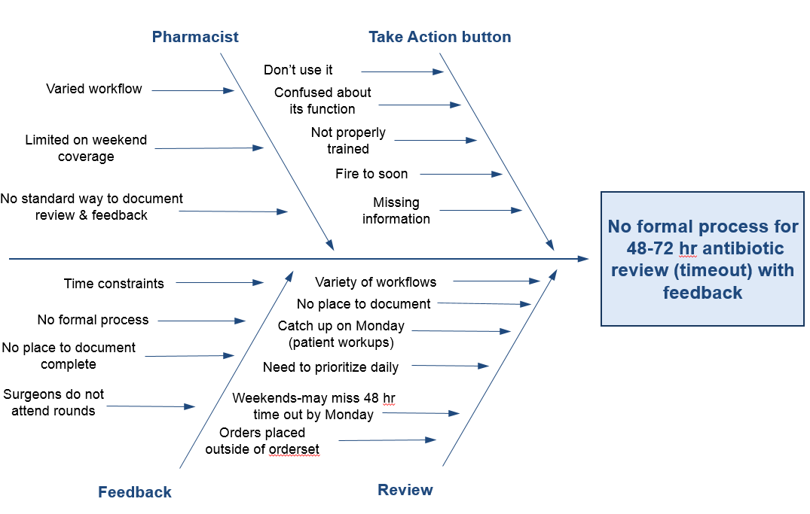
Problem Statement: No formal process for post-prescription review and feedback of targeted broad spectrum IV antibiotics (Cefepime, Meropenem & Zoysn).
Owner & Department: Tyler Fischback, CWH Pharmacy
Home Team Sign Off:
Sponsor Sign Off:
Date:
1
Performance Gap
Currently 3 broad spectrum antibiotics in the CWH formulary have a 48hr timeout procedure. There is no formal procedure for review with feedback to the provider. In the current state informal feedback is provided to the prescriber 39% of the time.
CWH Pharmacy departmental goal for 2019 is for the identified broad spectrum antibiotics to have post-prescritption review and feedback given to prescribers 100 % of the time.
The CDC Core Elements and DNV NIAHO MM.8 recommend post-prescription review and feedback on all antibiotics. Post-prescription review and feedback is considered a best practice for reducing antibiotic resistance.
4
Action Plan
2
Current State – Process
5
Results – (## Days)
3
Root Cause Analysis
Copy and paste updated VSM as changes are made to process.
Also include process and outcome measures.
Notes:
Slide 1. Good morning Cindy Johnston RN Quality Improvement Specialist with Care Excellence
Today is my 30-day report out on a project I have been working on with the Antimicrobial Stewardship Committee and CWH inpatient pharmacy.

Slide 2
Problem Statement: No formal process for Post-Prescription Review and Feedback of targeted broad spectrum IV antibiotics (Cefepime, Meropenem & Piperacillin/tazobactam.
Definition: Post Prescriptive Review & Feedback is a “drug timeout” at the 48-72-hour mark.
2019 Antimicrobial Stewardship (AMS) goal is to have a formal post-prescritption review and feedback given to provider and documented 100 % of the time.
In the current state informal feedback is provided to the prescriber 39% of the time.
Notes:
Our Problem statement Is that CWH has no formal process for Post Prescriptive Review and Feedback of targeted broad spectrum IV antibiotics.
Definition: Post Prescriptive Review & Feedback is a “drug timeout” at the 48-72-hour mark.
Stewardship 2019 goal is to have a formal review and feedback to providers 100%.
In the current state informal review and feedback is happening 39% of the time.

Slide 3

Formal Post-Prescription Review and Feedback: Why?
Drive more definitive therapy for the patient.
Prevention of resistant strains of bugs in our community.
Meet CMS & DNV AMS recommendations.
Meet AMS Goal to decrease broad spectrum antibiotic use.
Provide best practice guidelines to providers.
Improved clinical outcome-potential decreased days of therapy length of stay.
Notes:
Slide 2.The Why: Establishing a Formal process will:
Drive more definitive therapy for the patient
Work towards prevention of resistant strains of bugs in our community.
Meet CMS & DNV Recommendation
Meet the goal of reducing overall broad spectrum antibiotics usage
Provide best practice guidelines to providers
Impact clinical outcome with potential decrease in days of therapy and length of stay for our patients receiving ABX therapy.
Aligns with CH Strategic Goals:
Understand and Exceed Customer Expectations
Delivery of the Best Practice of Medicine-
Regional Care
By selecting the correct drug or stopping the drug or changing the route, potentially decrease length of stay, decreasing our days of therapy and preservation of our antibiogram

Slide 4
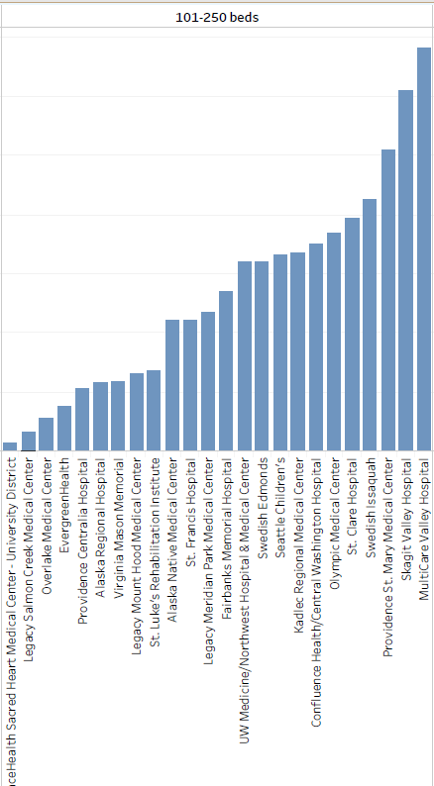
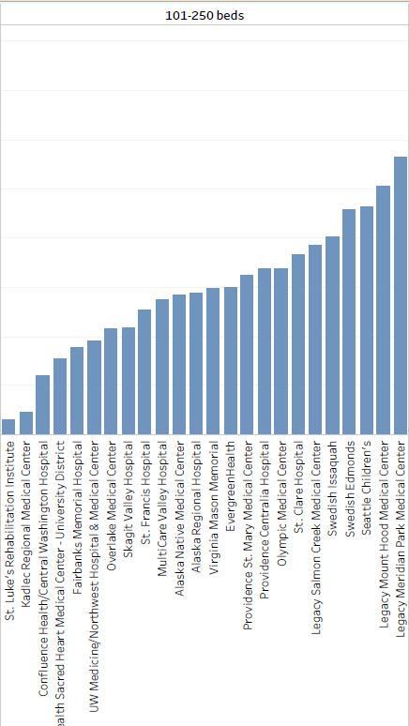
Carbapenems
-use is higher here than in 65% of 250+ bed hospitals
cephalosporins
Notes:
Slide 4 Here is a brief look at some data from WSHA demonstrating CWH’s overall broad spectrum usage is higher than 65% of hospitals our size,
and a good alternative drug choice is underutilized at CWH, with usage less than other hospitals our size.

Slide 5
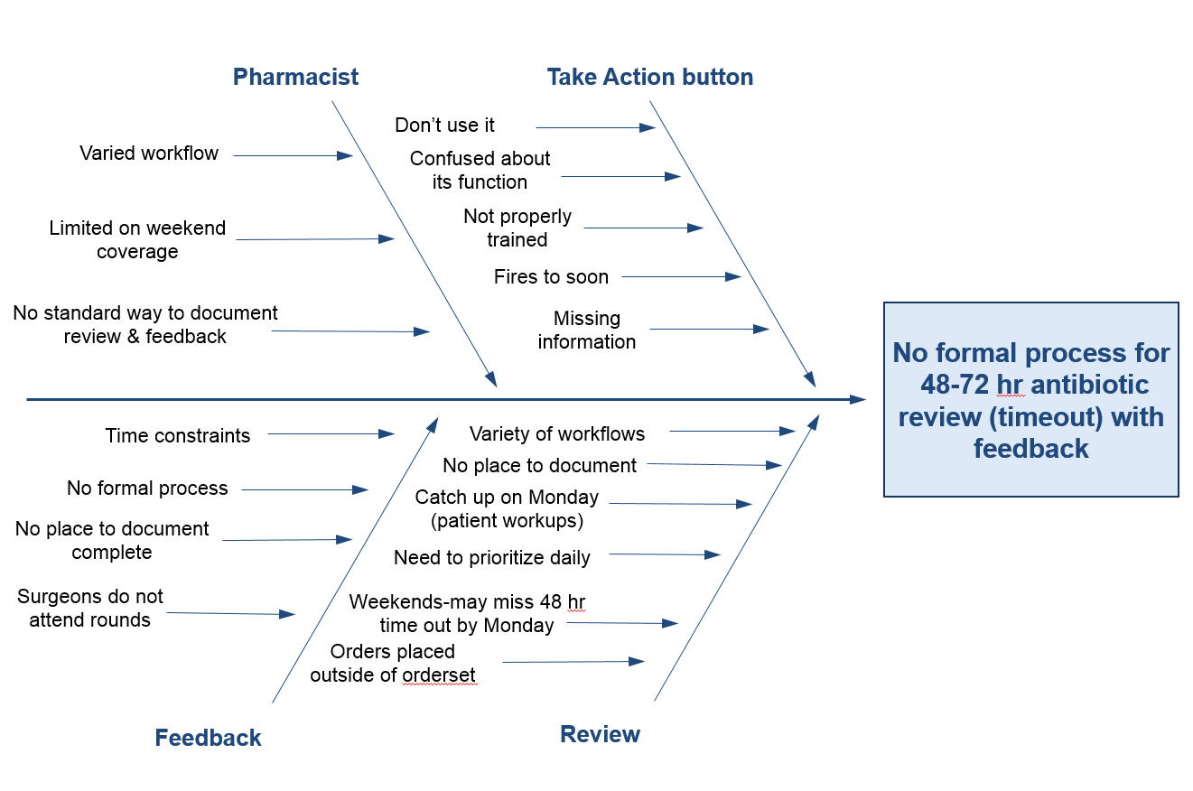
Notes:
Slide 5. Several root causes have been identified:
Specifically the Take Action button which is meant to trigger a pharmacist ABX review was firing too soon, it was confusing, had missing information, and staff lacked training.
There was no formal process to review, provide feedback and document.
No standard way to communicate recommendations to providers, specifically those who were unable to attend rounds.

Slide 6
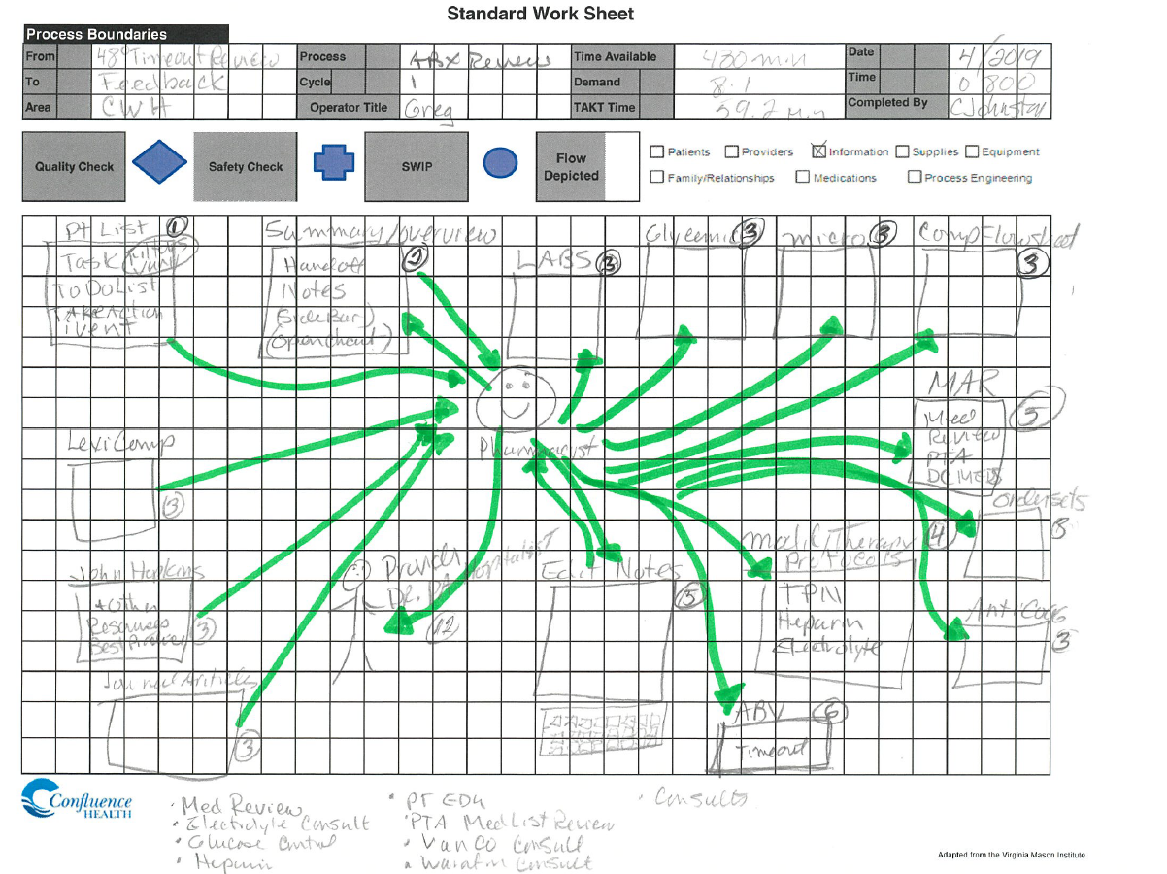
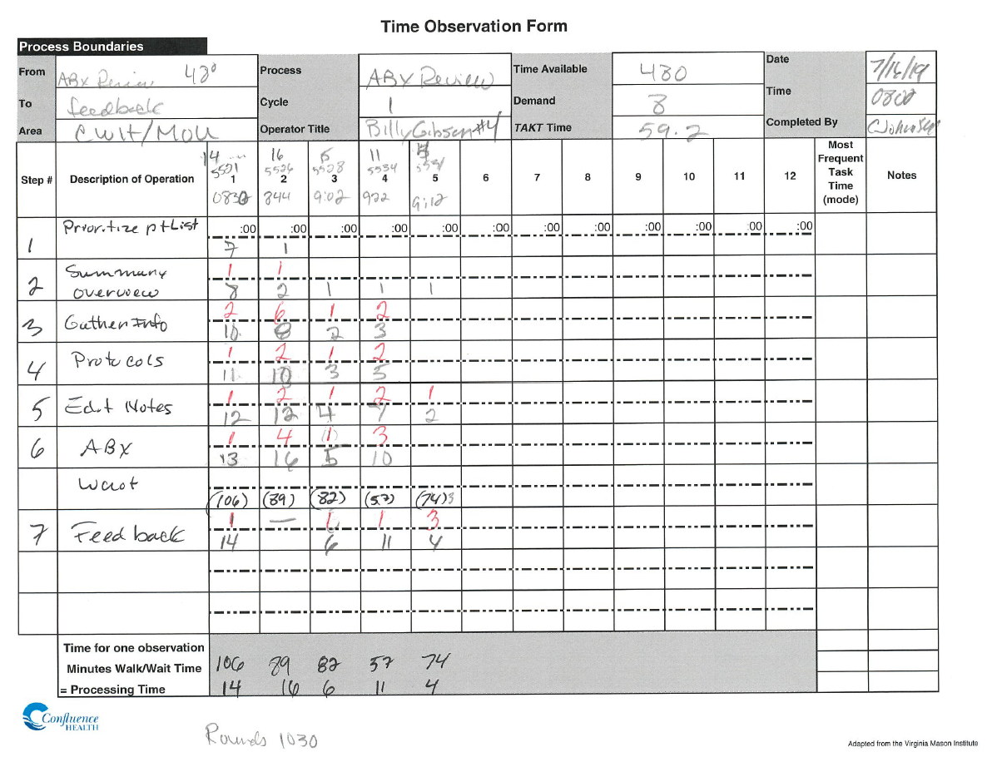
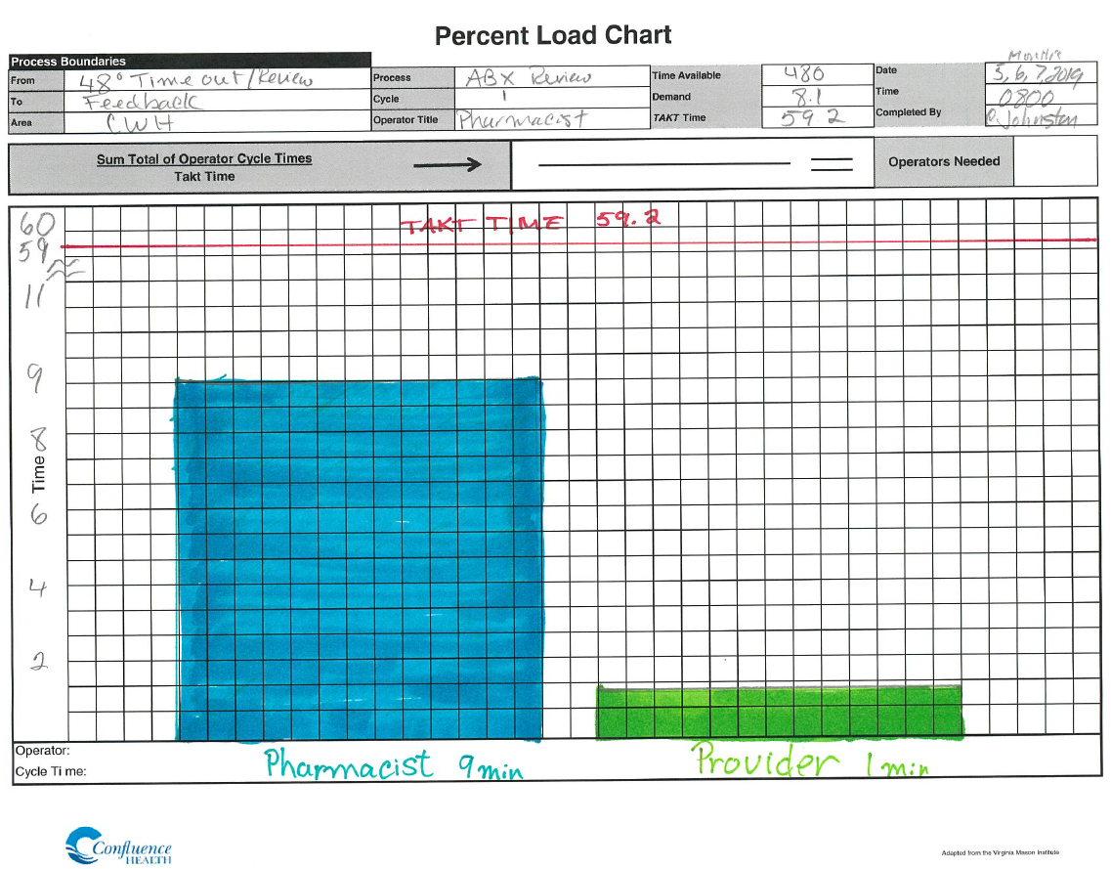
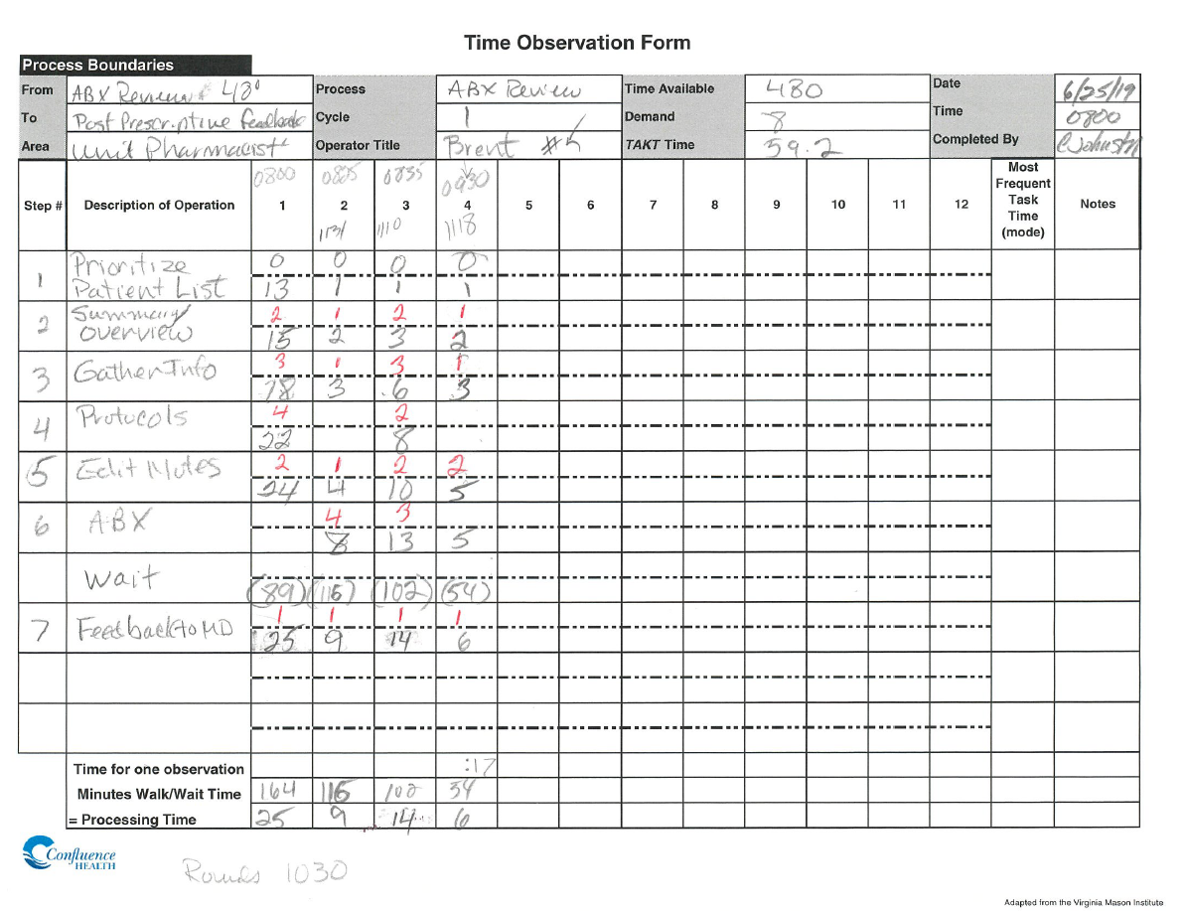
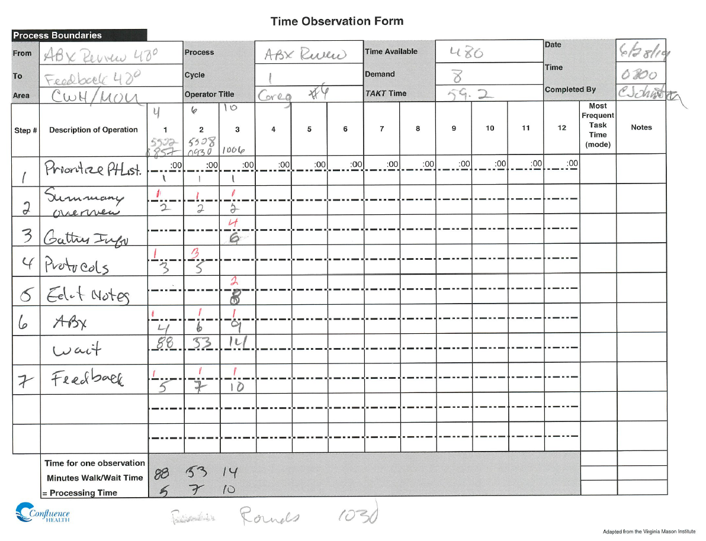
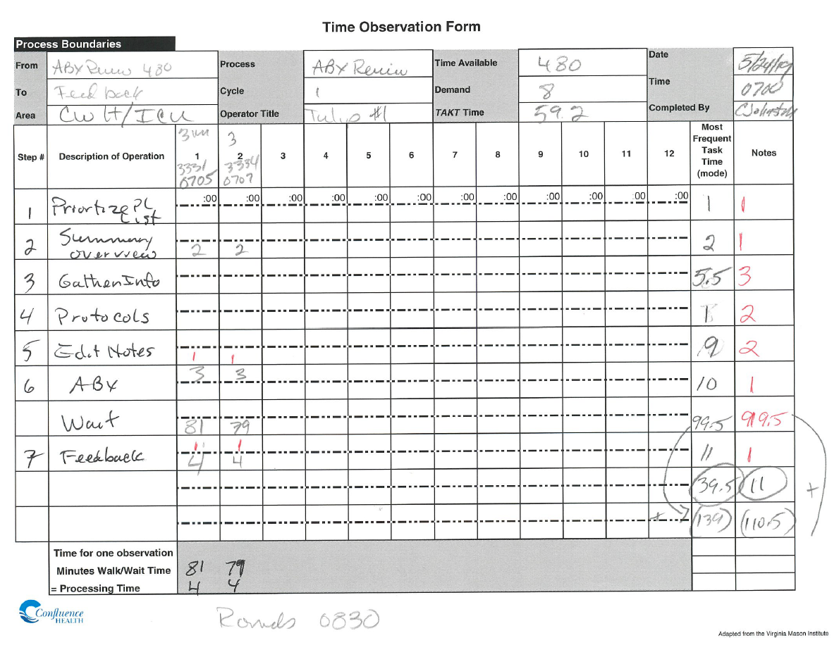
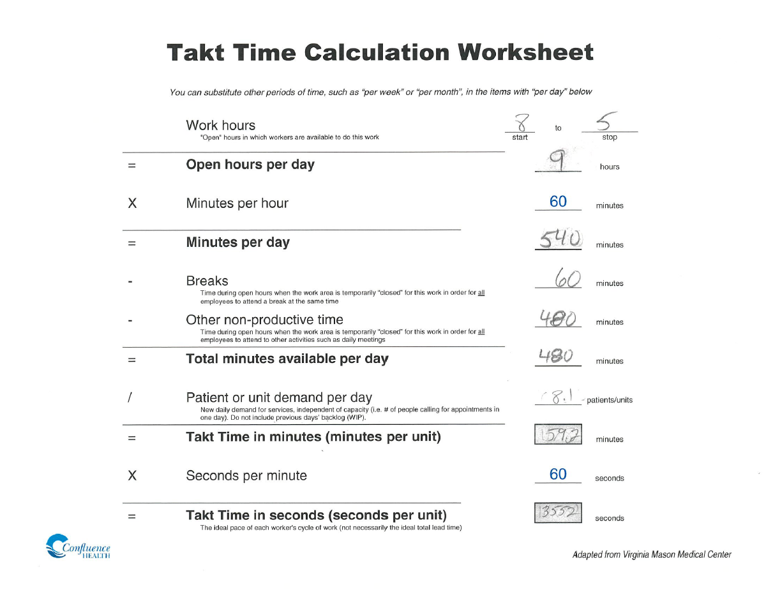
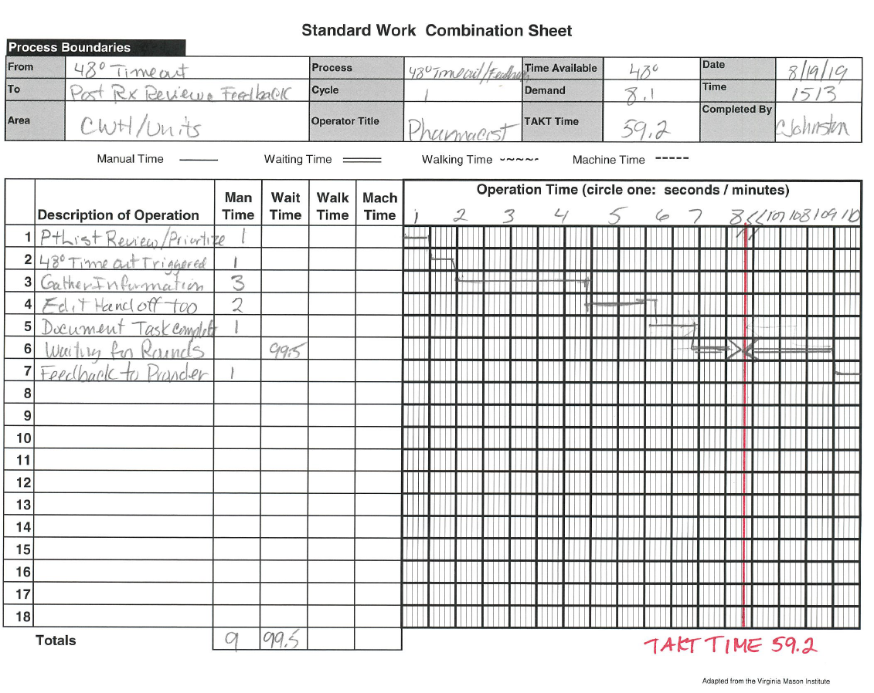
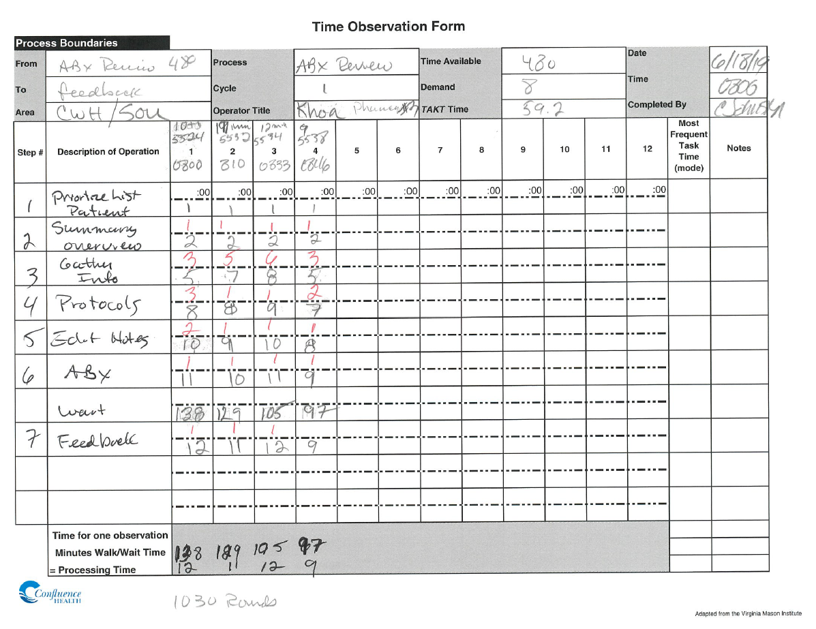
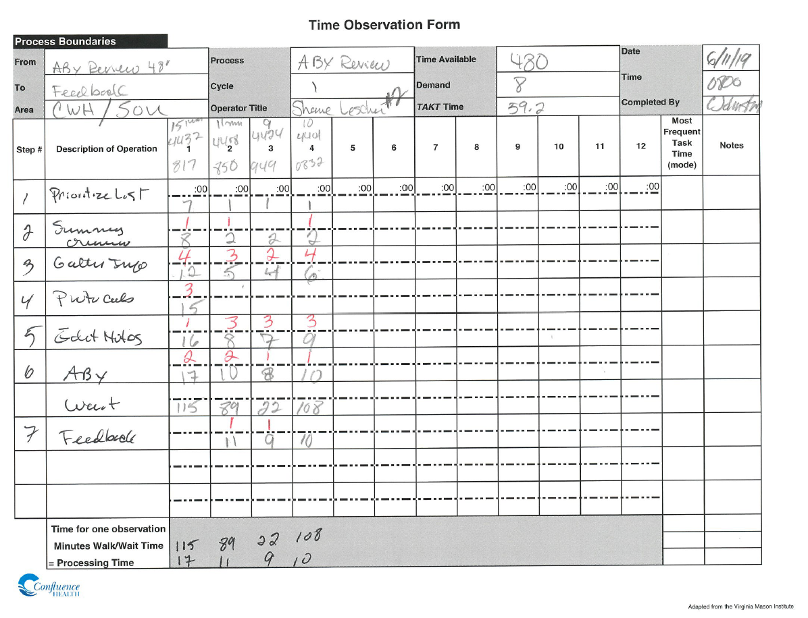
Notes:
Slide 6. These CHVS tools used to gather and document information from observations, timings and interviews.

Slide 7
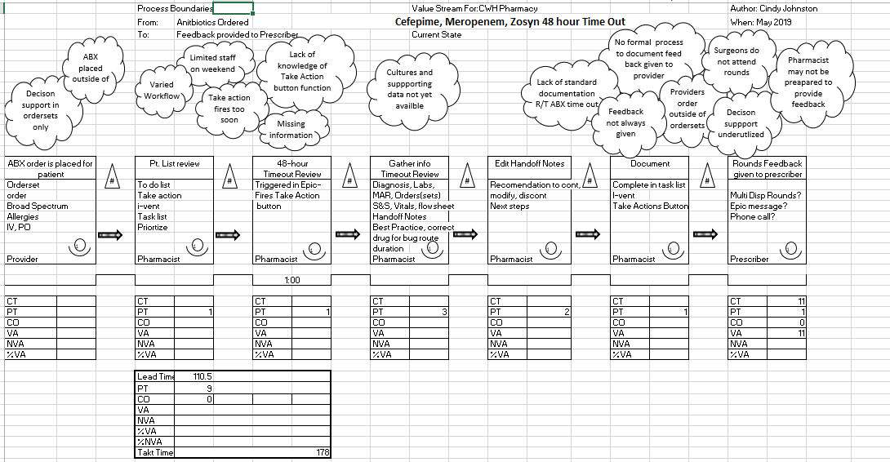
Notes:
Slide 7. Clouds in the value stream map helped us too see the whole process with:
Varied workflows
A knowledge deficit related to EPIC tools specifically the “Take Action Button”,
Inefficient EPIC tool.
No formal process to document reviews and provide feedback.
No process to communicate to providers not able to attend rounds.

Slide 8
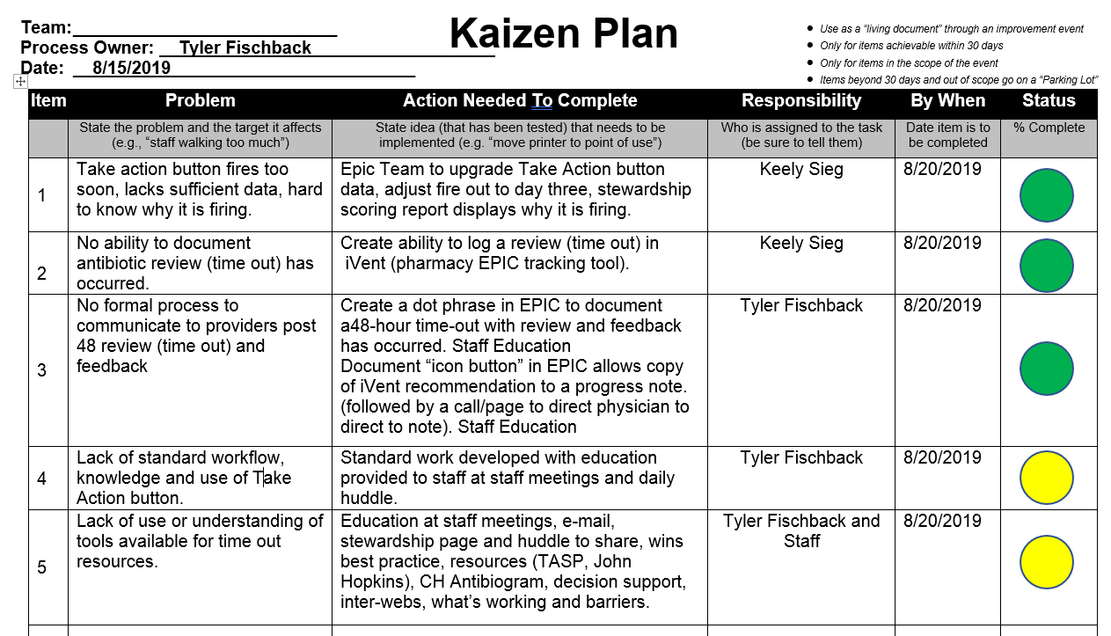
Notes:
Slide 8..Tyler has Really energized his staff and they have collaborated in staff meetings to come up with some with Great actions plans to eliminate several clouds in the value stream map.
Adjusting the timing of the “Take Action Button” to fire on day three, to allow for two full days of ABX therapy prior to a pharmacist review
The pharmacist “iVent task tracking tool” was determined to be the standard work process for logging Post Prescriptive Review and Feedback.
A DOT phrase was developed in EPIC to enable pharmacist to communicate and document a Formal Review and Feedback to the provider.
Review and feedback will be the daily huddle focus for two months.

Slide 9
Notes:
Slide
9. As you can see we have eliminated many clouds, some clouds are outside of the scope of this project and will be placed in the parking lot to be addressed later.
The Formal Process Go-live was Aug 19th a Snap shot for August of targeted broad spectrum IV antibiotics usage shows a 21% decrease, its too early to tell if this is coincidental or related to the Formal Review and Feedback Process.

Slide 10
Ivent Task Audit August 2019
Pre Go-Live
39% Targeted ABX reviewed
Post Go-Live
80% Targeted ABX reviewed 16/20
plus additional 21 ABX reviewed
(10 Day Snap Shot)
Notes:
Additionally 10 day snap shot of post go live ABX review tracked in iVent demonstrates an increases from 39% to 80% antibiotics reviewed with formal feedback given to the provider.
Pre go live
Narrowed-7 accepted % unknown
Stopped-2 x accepted % unknown
Continued-9 accepted % unknown
Expanded-0
Post Go Live
Narrowed-17, 65% accepted
Stopped-10, 60% accepted
Continue-13,-54% accepted
Expanded-1, 100% accepted

Slide 11
Next Steps
Continue daily huddle sharing wins and barriers
Audit iVent, review and feedback
Audit overall targeted antimicrobial usage
Monitor for sustainability
Continue PDSA cycles
Expand to WVH
Notes:
Slide 10.
Continue daily huddle sharing wins and barriers
Audit iVent, review and feedback
Audit overall targeted broad spectrum IV antibiotic usage
Monitor for sustainability
Continue PDSA cycles
WE Look forward to coming back in 60 days to report how the changes are impacting our outcomes measures.

Slide 12
Practice Council
Champions
PDSA Ideas form the group

Slide 13
Thank You
Tyler Fischback
Greg Stahly
Brent Bell
Clari Ramos
Shane Lescher
Khoa Nguyen
Billy Gibson
Megan Lenz
James Leifheit
Keely Sieg
Alesha Perrin
Notes:
Slide 11. Thank you
What questions do you have?

Slide 14
Sixty Day Follow-up

Slide 17
Targeted Broad Spectrum Antibiotic Monthly Review
Pre Go-Live
Month

Slide 18
CWH Days of Therapy

Slide 19
CWH Days of Therapy

Slide 20
CWH Days of Therapy

