Slide 1
Antibiotic Timeout: PDSA
A timeout on our timeout

Slide 2
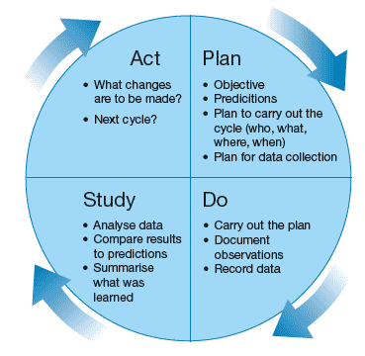
What is PDSA?

Slide 3
Recognition
The team went from 39% timeout rate to ~60%!
Acceptance rate 75% +
Decreased the amount of broad spectrum DOT
Timeout champions

Slide 4
Study and Act Phase
Analyze our data
Summarize what was learned
Decide what changes need to be made
Prepare for next cycle

Slide 6
Targeted Broad Spectrum Antibiotic Monthly Review
Pre Go-Live
Month

Slide 7
CWH Days of Therapy

Slide 8
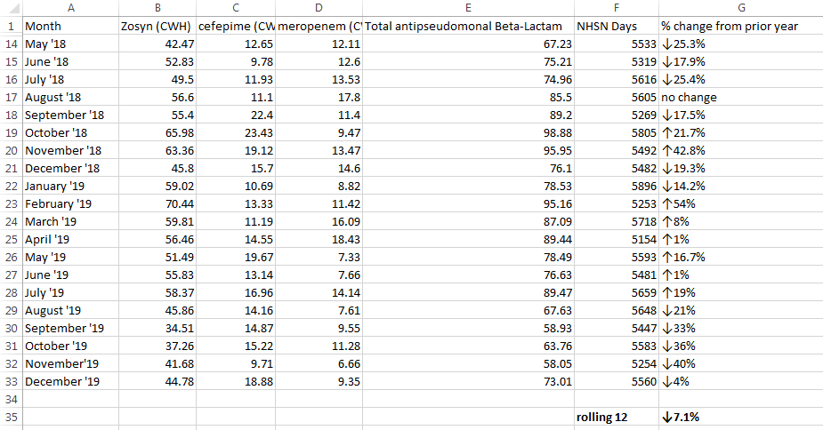

Slide 9
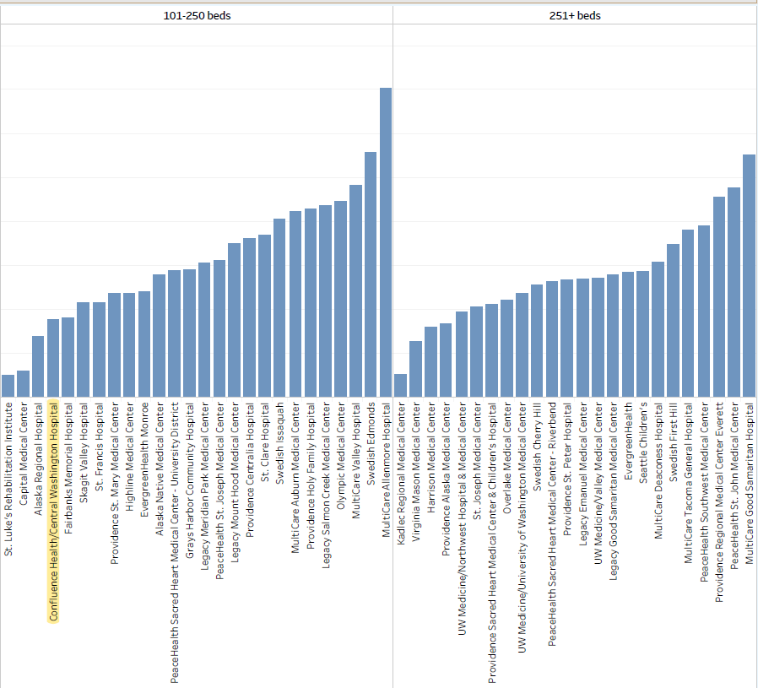
Cephalosporins

Slide 10
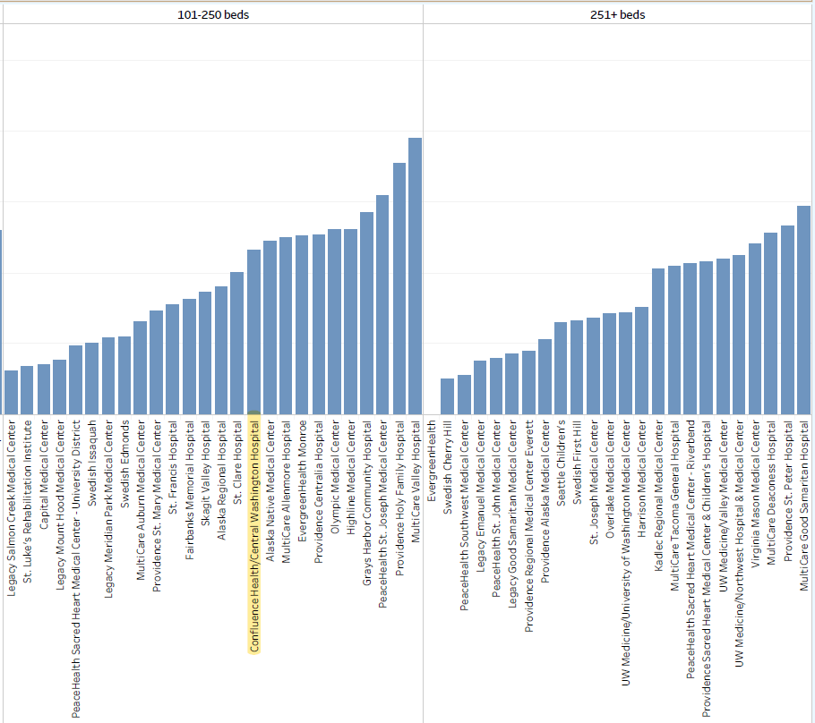
Penicillins: Pip/Tazo

Slide 11
Questions?
What is a reasonable goal for % complete?
Is this cemented in our workflows (i.e. Has this become habit?)
What barriers exist? (confusion, confidence, knowledge gaps, etc)
How do we get support to those who need it?
What specific areas of identified clinical opportunity can we focus in on?

Slide 12
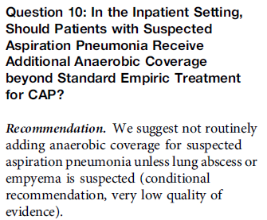
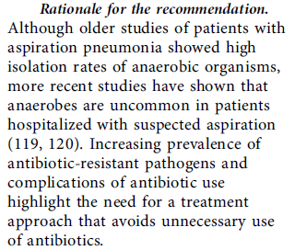

Slide 13
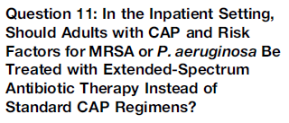
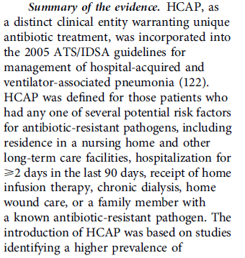
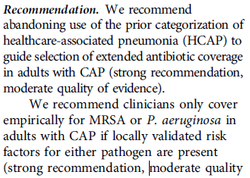
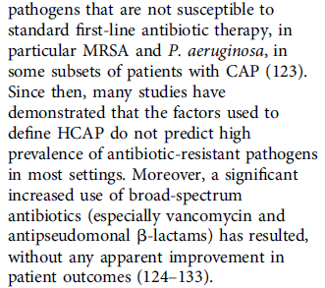

Slide 14
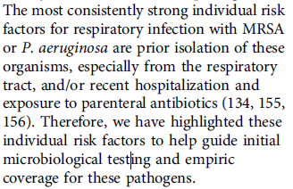
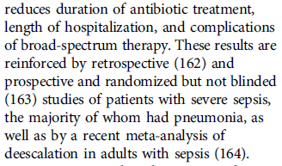
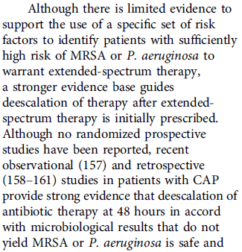

Slide 15
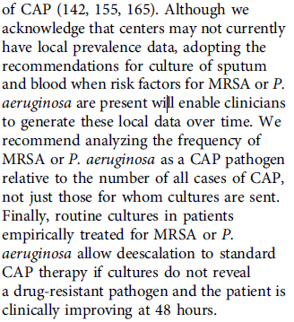
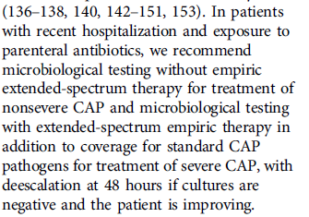

Slide 16
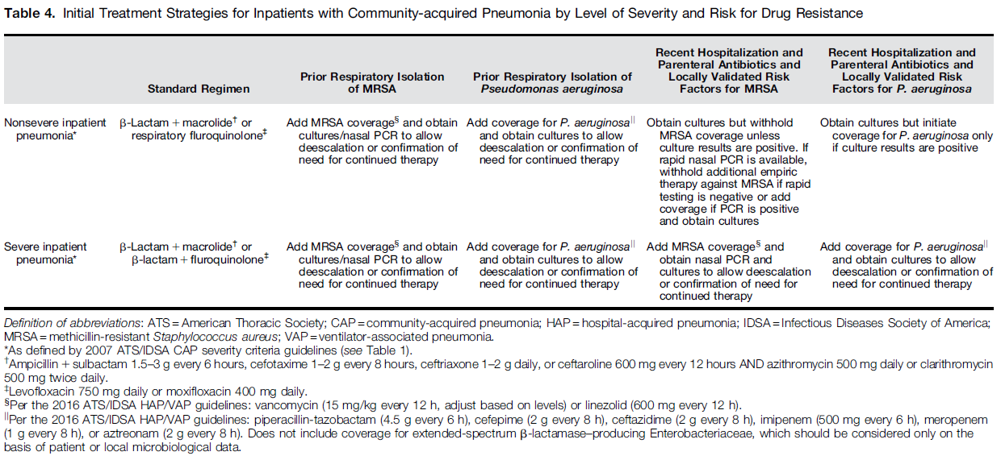

Slide 17
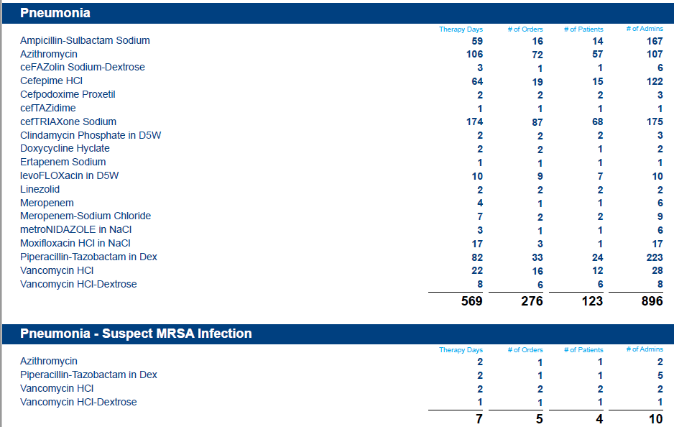

Slide 18
What Tools are Available to Us?
Guidelines (CAP)
Institutional Data
Antibiogram
MUE

Slide 19
TakeAways
Unasyn = 10 % of all PNA therapy days
Pip/Tazo, meropenem, cefepime = 27.6 %
CTX = 30%
Consider using traditional CTX/Azithro regimen empirically for most PNA
If empirically treating for PSE or MRSA, send blood and sputum cultures
For non-severe CAP and no previous respiratory colonization of PSE or MRSA, do not give pip-tazo or vanco
For severe CAP on empiric pip-tazo, de-escalate at 48 hours if no growth (Abx TO)

Slide 20
Questions?

