Slide 1

Union General Hospital
Financial February: Advocating for resources
Kate Cook, PharmD
Pharmacy Director

Slide 2
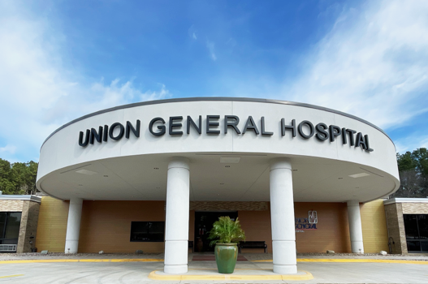
A little bit about us…
Located in Farmerville, La. – Northeast La. Region 8
Full service 20-Bed Critical Access Hospital with Acute & Skilled care
24-7 Emergency Department
Rural Health Clinic
Intensive Outpatient Program for Medicare patients
Outpatient Therapy Services – PT, OT, ST

Slide 3
STARTED FROM THE BOTTOM:
OUR TEAM
NOW WE ARE HERE:
  CO-LEADERSHIP
    MD AND PHARMD
  ALL PROVIDERS
  CM
  ED
  HIM/QA
  IPC
  LAB
  NURSING
  RHC
  MEETINGS ARE HELD QUARTERLY
  DATA
-CEO
-CM
-ED
-IPC
-Lab
-Nursing
-Pharmacy
-QA
-RHC

Slide 4

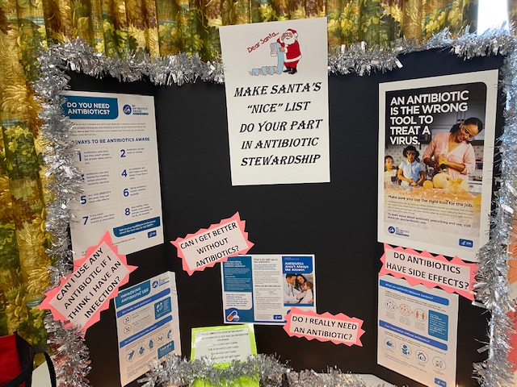
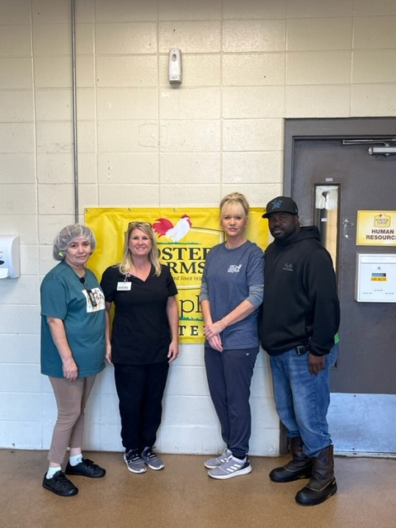

How we got started & why…
Got the ball rolling at the end of 2016 out of necessity
Our initial antibiotic stewardship group met monthly in the beginning to get established then eventually worked our way to quarterly meetings
After establishing policy worked on tracking and improvement interventions
More recently worked on staff & community education
Community Training
All Staff Training

Slide 5
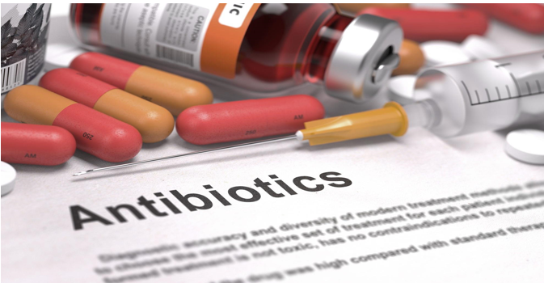

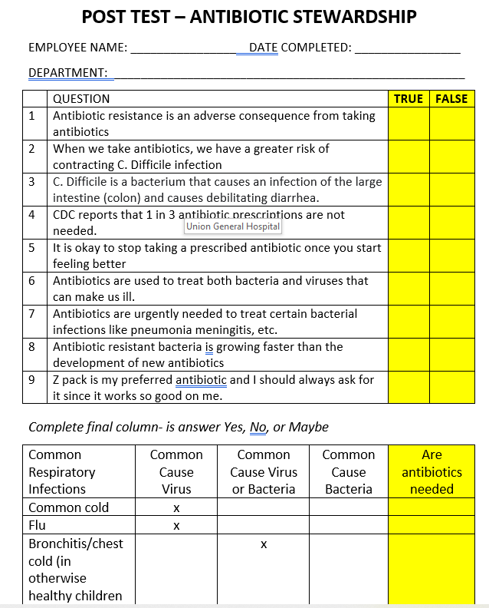
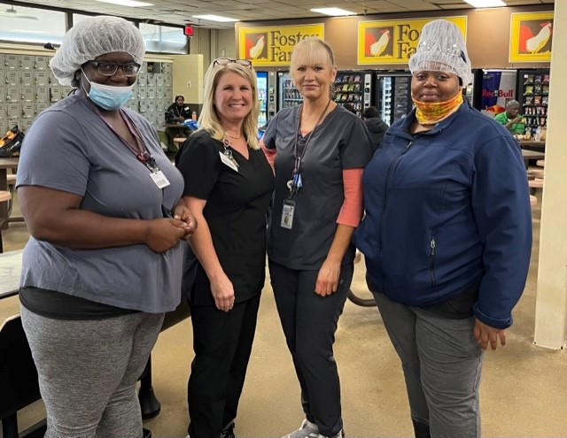
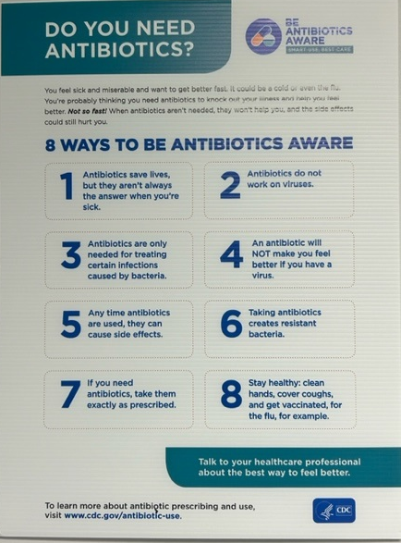
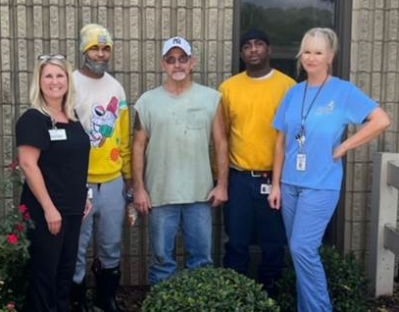
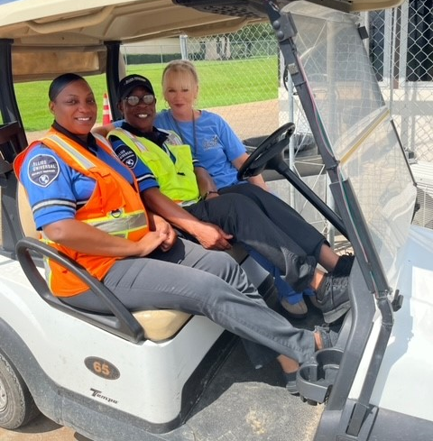
Epocrates Subscriptions for 4 providers
Union General Hospital Antibiotic Stewardship
Focus Areas & Process Changes…
Created an Infection Control Exhibit to include Antibiotic Stewardship training where we had games & prizes for all hospital staff.
Added training to orientation and annual training requirements for staff including a Post-Test
Created a Carelearning Module as part of our new hire orientation and annual training for employees
Purchased Epocrates+ (a Point of Care Medical Application) for Medical Staff & an “Up To Date” subscription for one of our physicians.
Our Infection Preventionist spent 1 day a week for 8 weeks doing Community Awareness & Outreach Education to different businesses in our parish.
Purchased signage and that was hung in all Emergency Department & RHC patient rooms

Slide 6

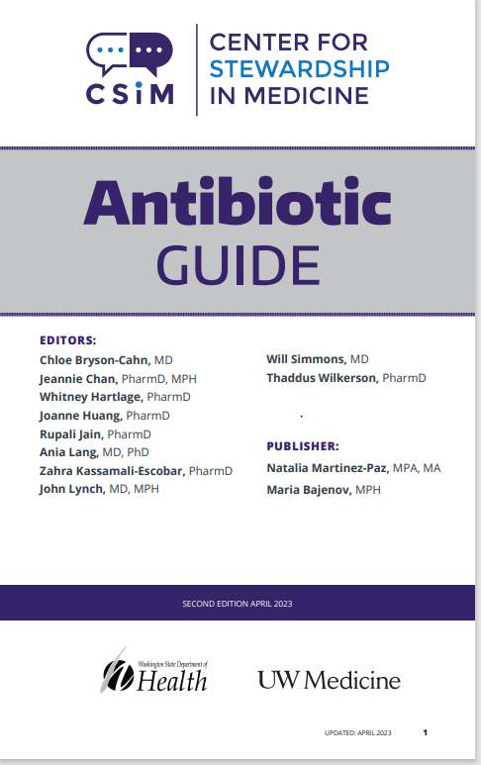

What are we doing next…
Purchased TASP (Tele-Antimicrobial Stewardship Program) to provide further education and resources for our clinical ASP team members.
  This includes weekly Zoom calls to discuss relevant ASP topics.
  An Antibiotic Guide for committee members
Joined ASB IQIC
  This includes monthly Zoom calls and quarterly coaching calls
  SMART goals implemented to measure improvement

