Slide 1
AUC: Tips & Tricks
The Ultimate guide for eliminating your fear of auc calculations
Updated: February 2020

Slide 2
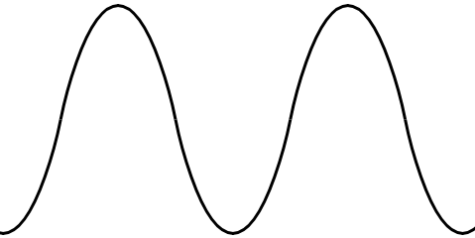
Peak & Trough
https://emcrit.org/pulmcrit/vanco/

Slide 3
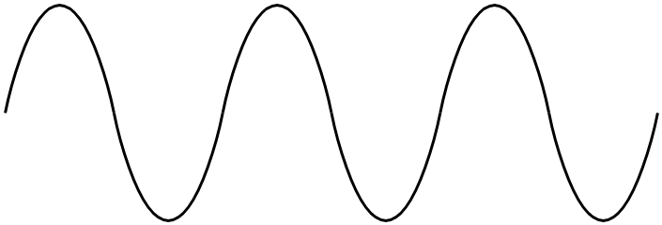
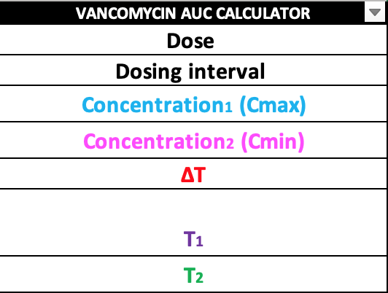





AUC: Defining the Variables
$$∆T$$
$$C_{1}$$
$$T_{2}$$
$$C_{2}$$
$$T_{1}$$
Time of Dose
Due time of Next Dose

Slide 4
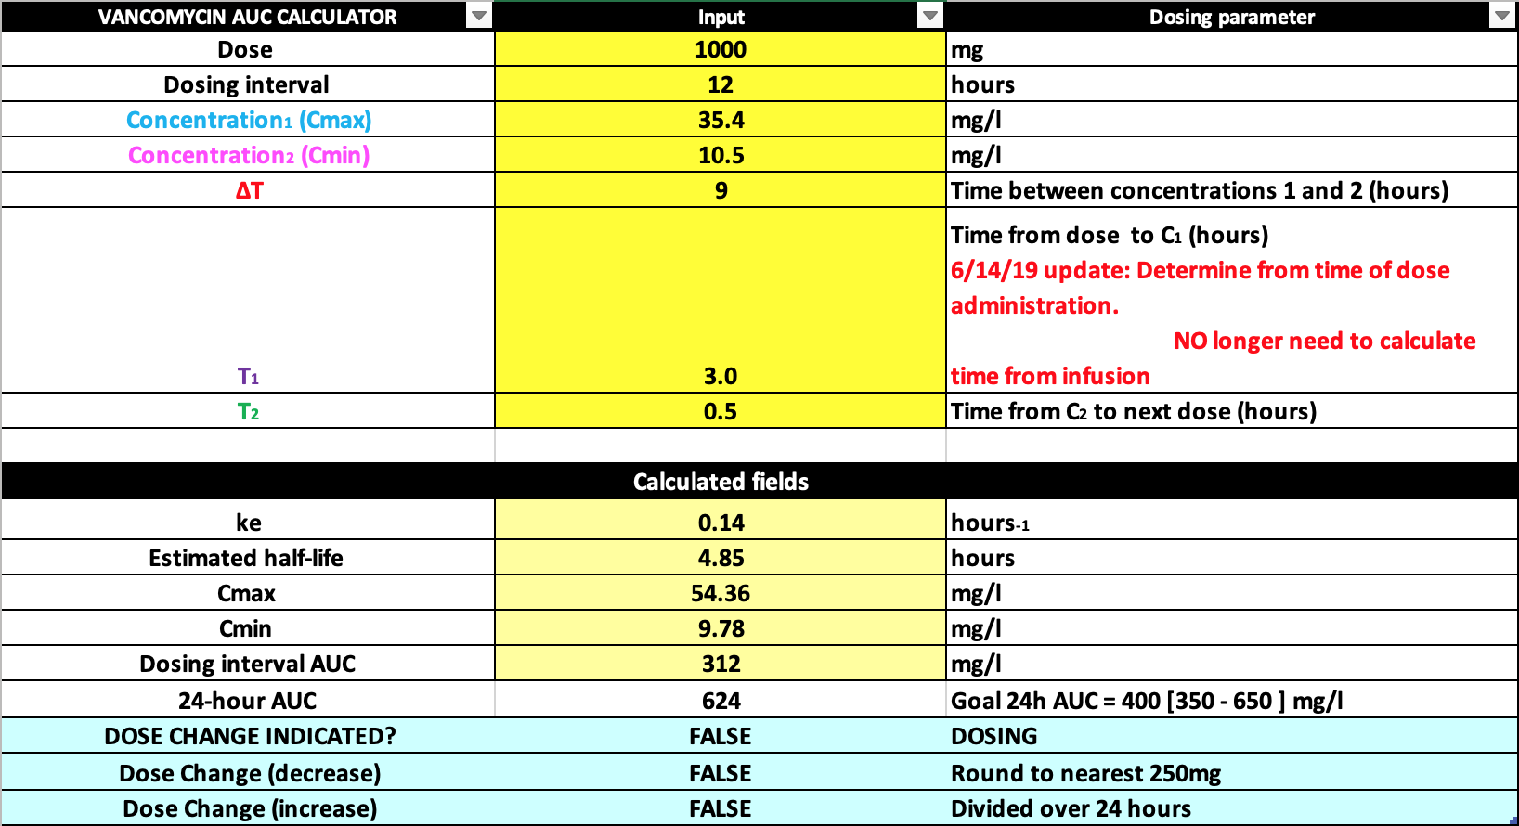



AUC Peak & Trough on the Same Dosing Interval
$∆T$= 8.5
Peak: 35.4 @ 1300
$T_{2}$= 0.5
Vt: 10.5 @ 2130
$T_{1}$ = 3
1000 mg IV
@ 1000
1000 mg IV @ 2200

Slide 5
AUC Peak & Trough on the Same Dosing Interval

Slide 6



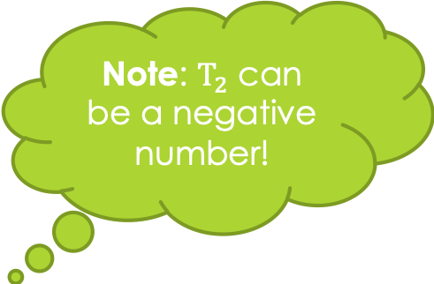
AUC Peak & Trough on Same Dosing Interval; Late Trough
$∆T$= 9.5
What would be a true trough @ 2130…
Note: $T_{2}$ can be a negative number!
Now is late @ 2230…
Peak: 35.4 @ 1300
Vt: 10.5 @ 2130
$T_{2}$= -0.5
Vt: 8.5 @ 2230
$T_{1}$ = 3
1000 mg IV
@ 1000
1000 mg IV @ 2200

Slide 7


AUC: Peak & Trough on Different Dosing Intervals
$∆T$= 8.5
Peak: 35.4 @ 1300
Peak: 35.4 @ 0100
$T_{1}$= 0.5
Vt: 10.5 @ 2130
$T_{1}$ = 3
$T_{1}$ = 3
1000 mg IV
@ 1000
1000 mg IV @ 2200

