Slide 1

F-ASB
March 3, 2022
Project Management Fundamentals and Tools for Success
Natalia Martinez-Paz, MA, MPA

Slide 2
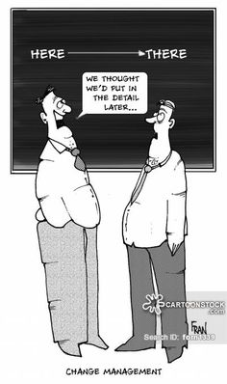
Life Cycle of Projects
What work must be accomplished
What deliverables must be generated and reviewed
Who must be involved
How to control and approve each phase
https://www.smartsheet.com/blog/demystifying-5-phases-project-management

Slide 3
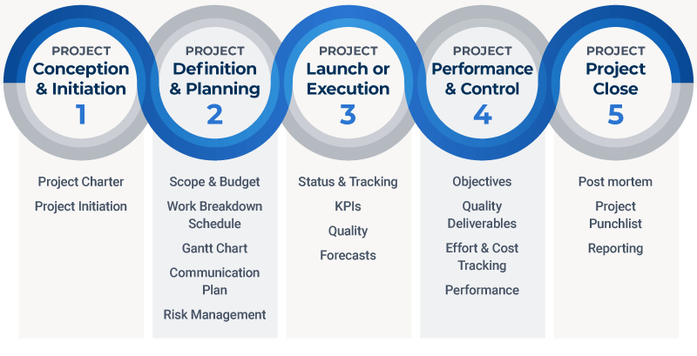
5 Phases of Project Management
SMART Goals
PDSA
https://www.smartsheet.com/blog/demystifying-5-phases-project-management

Slide 4
Gantt Chart 101
YUP
Project phases and schedule
Milestones and timeline
Sequence of events and progress tracking
Track dependencies
NOPE
NOT THE PROJECT PLAN
Not for organizing
Notes:
Gantt is a supporting document and visual tool!

Slide 5

Key Gantt Elements
Resources: resources for tasks outlined in a Gantt chart, in order for each to be completed on time.
Milestones: Small and large milestones must be hit in order to keep your project on track.
Tasks: There are specific things that need to be completed along the way of your project.
Dependencies: Tasks on your Gantt chart will be related to each other.
  Ex: Natalia won’t be able to complete her task of routing the Pocket Guide to print until Zahra has met her milestone and submitted her final approval.
https://blog.hubspot.com/marketing/gantt-chart-example

Slide 6
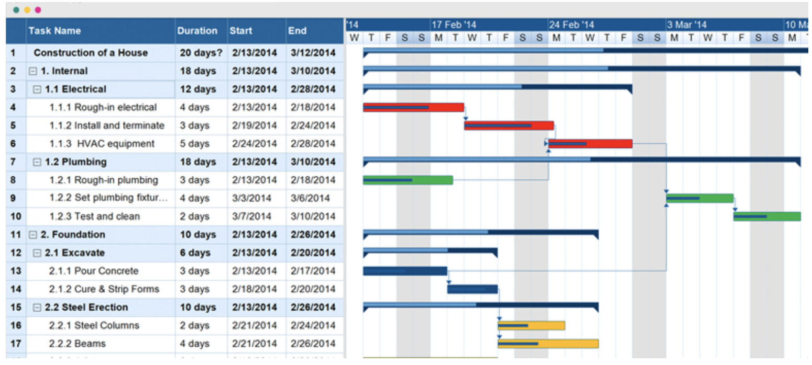

Slide 7
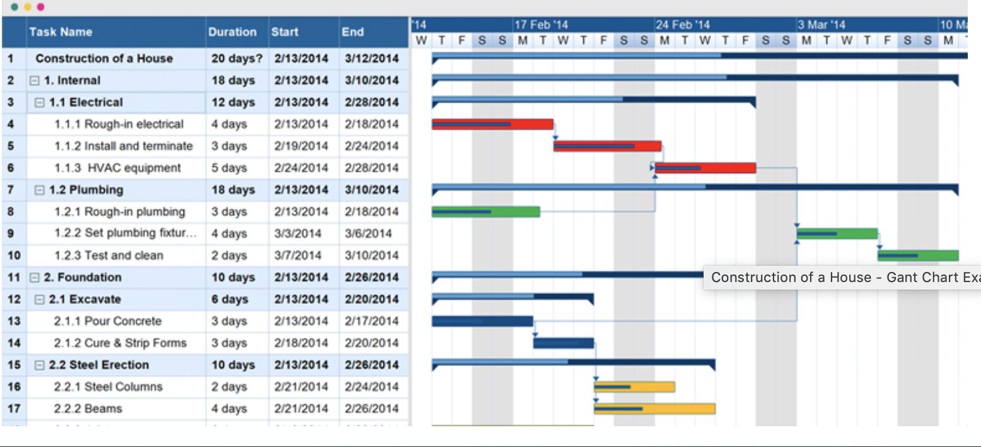
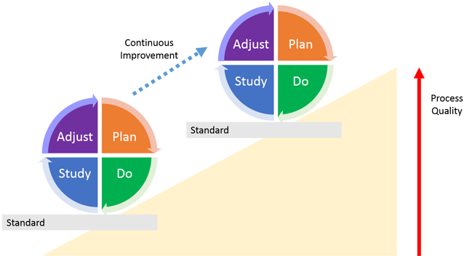
Supporting PDSA
https://blog.kainexus.com/continuous-improvement/improvement-disciplines/lean/pdsa/a-scientific-approach-to-continuous-improvement

Slide 8
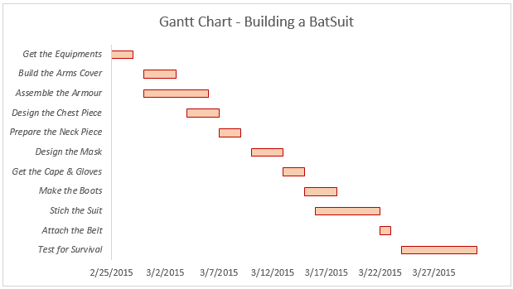
Simple Gantt Charts
https://trumpexcel.com/gantt-chart-in-excel/
Notes:
activities or tasks that are to be done, running along the y-axis; milestones or progress stages indicated along the x-axis (either on the top or bottom of the chart); and progress bars, denoted as horizontal bars, denoting how far along each task is at any given point.

Slide 9
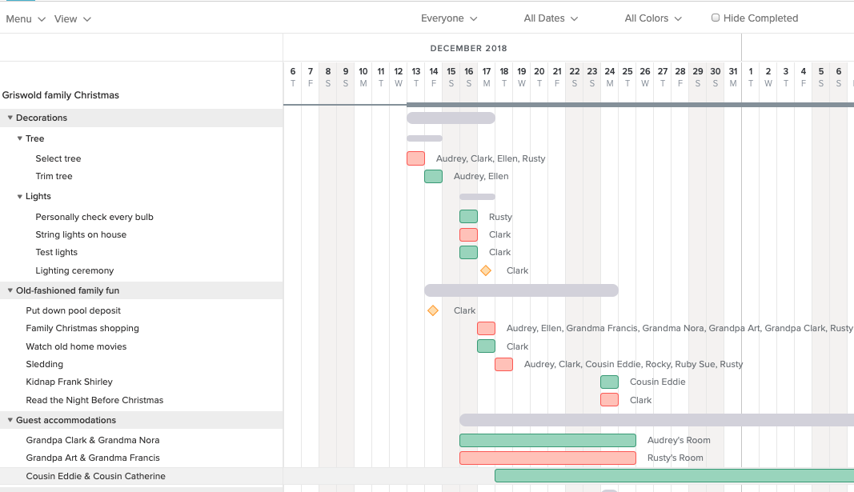
More Detailed Gantt Chart
https://www.teamgantt.com/blog/holiday-event-planning-gantt-chart

Slide 10
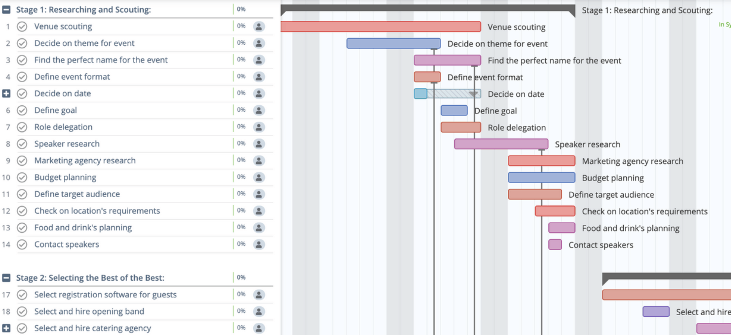
Dependencies – Event Planning
https://instagantt.com/event-planning-template-event-planner

Slide 11

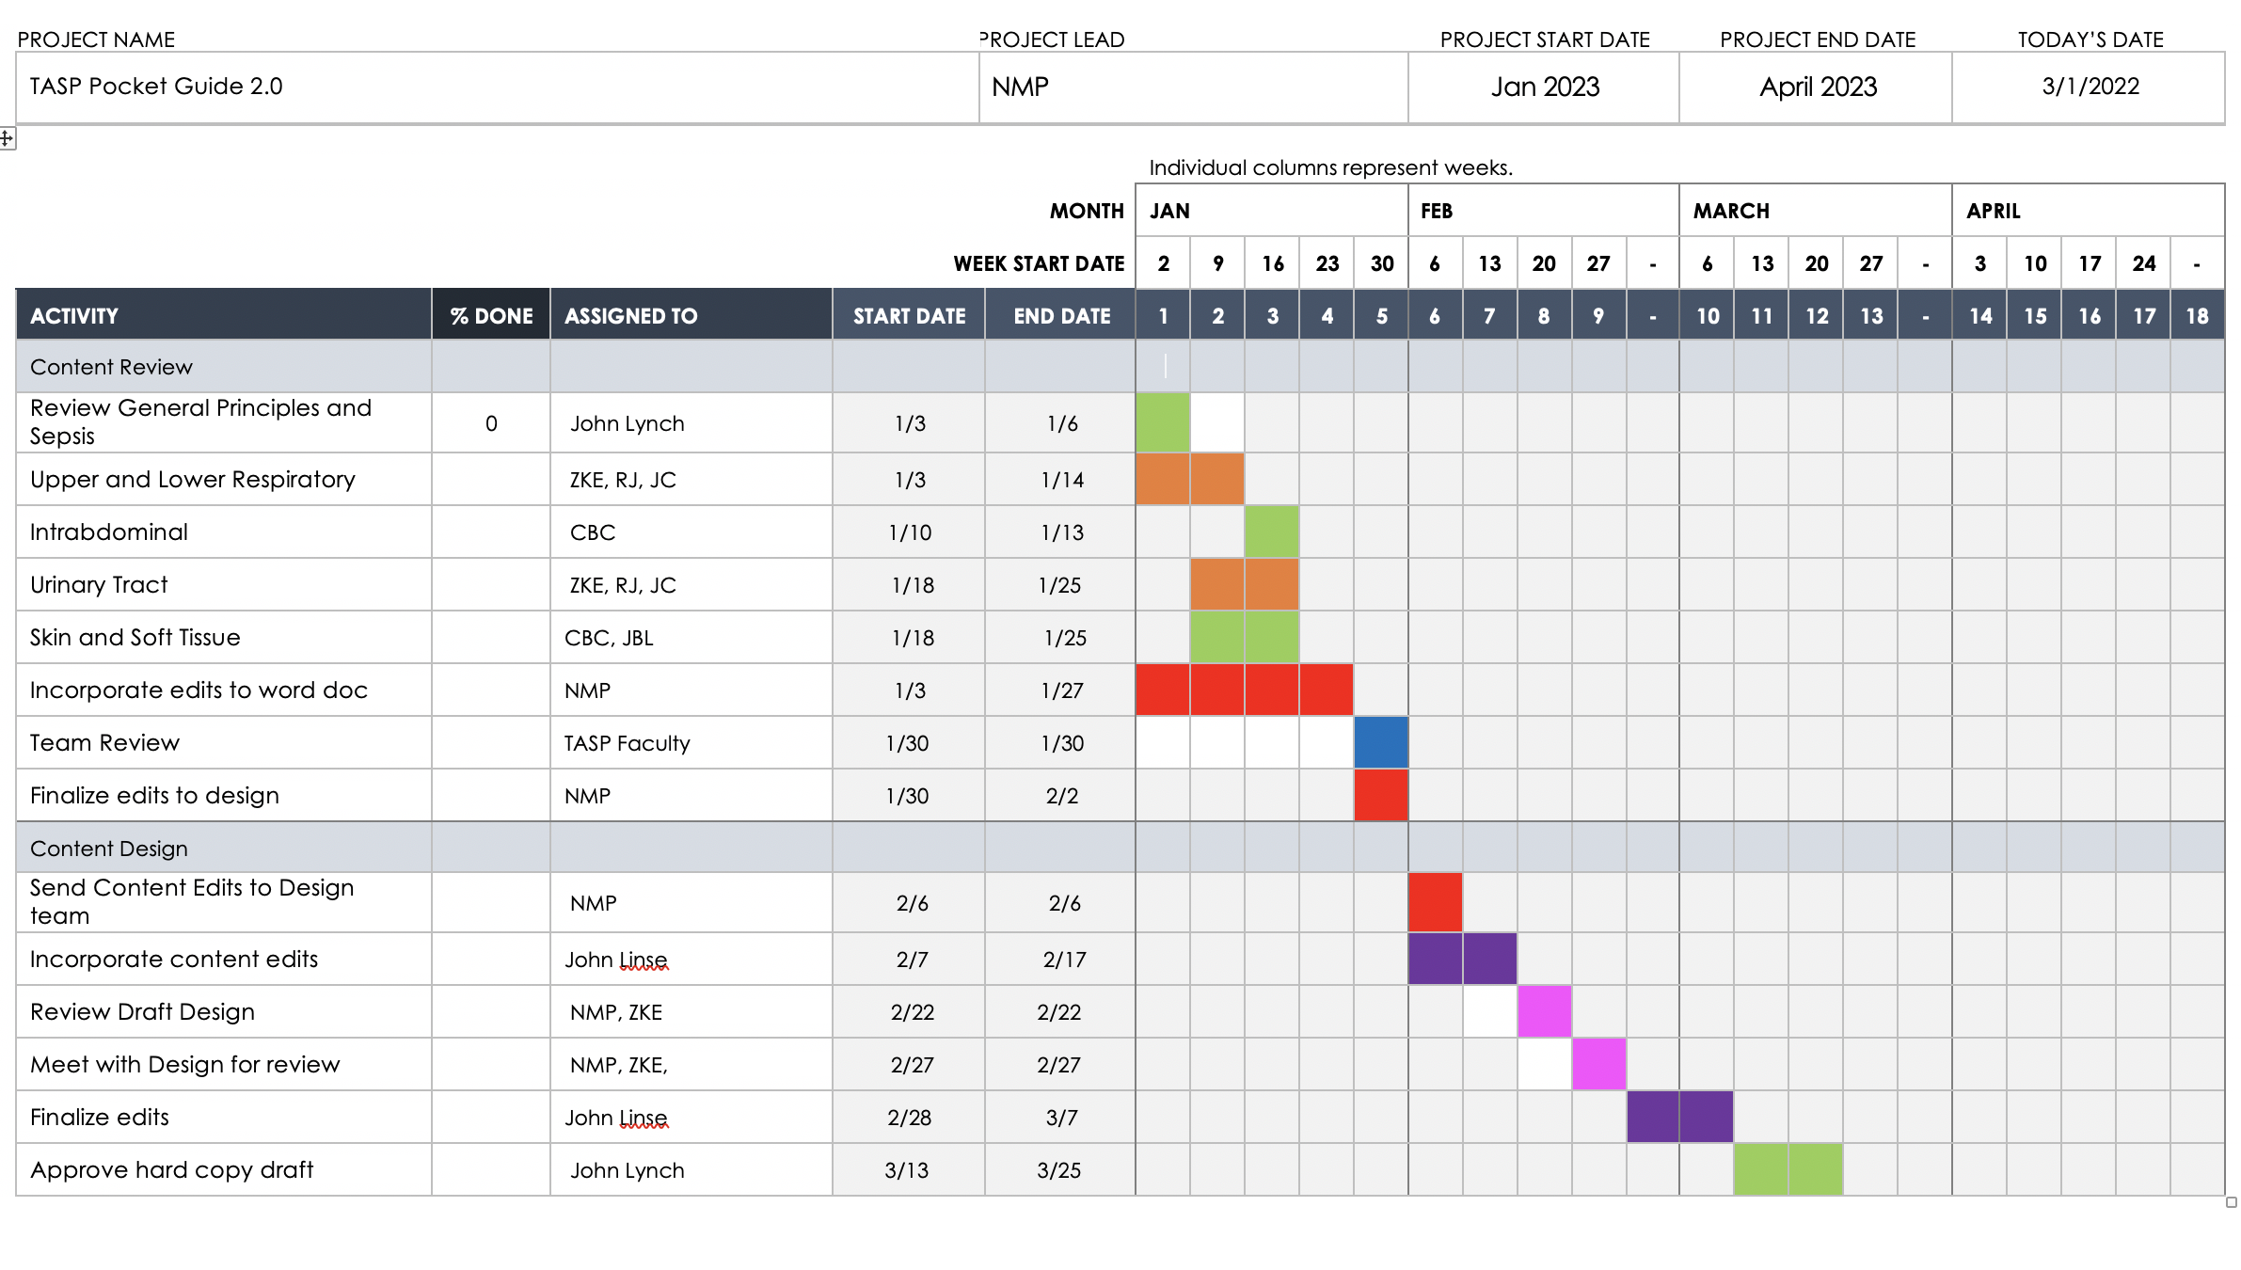
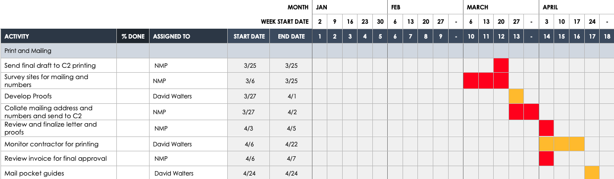
Gantt Charts in Action
Notes:
1. Who is going to see this and how often?
2. Review of Gantt pieces

Slide 12
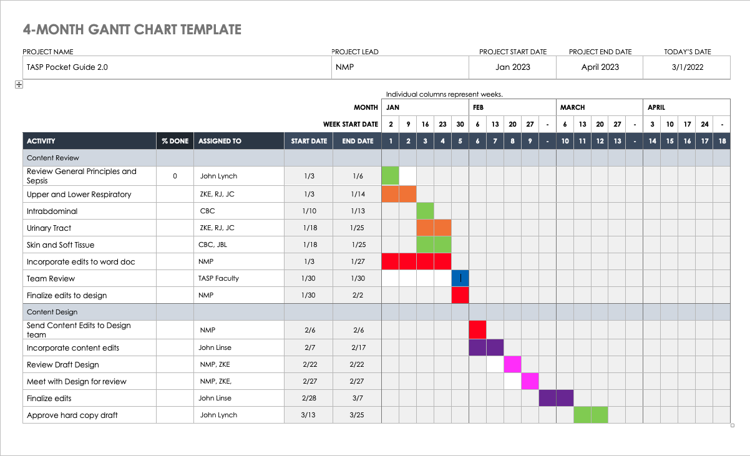
Identifying and Mitigating Challenges
Notes:
Where are my trouble spots going to be?
How can I mitigate those?
Clearly communicate expectations and timeline
Schedule working meetings
Add projects to people's calendars and attach documents

Slide 13

Identifying and Mitigating Challenges
Notes:
What is outside of our control?
Keeping communication constant and clear. Emphasize overall process and progress. We want to avoid making gantt chart being obsolete.

Slide 14
Gantt Chart Pro/Con
PRO
High level overview
Helps manage resources
Better tracking – helps keep everyone aligned
Shows overlaps
Makes complex info digestible
CON
Time consuming set up
Complex and confusing if too detailed
Does not show the amount of work each task requires
Notes:
Gantt is a supporting document and visual tool!
YOU MUST USE IT

Slide 15
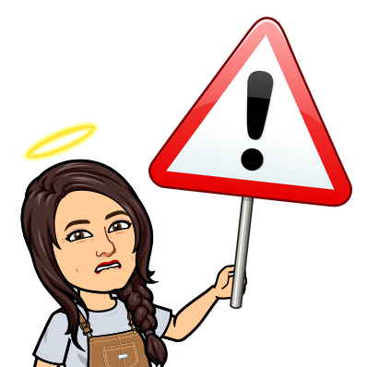
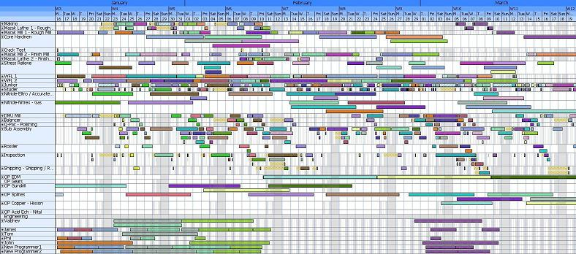
Mega Gantts. Don’t Do This.

Slide 16
Supporting PDSA
https://blog.kainexus.com/continuous-improvement/improvement-disciplines/lean/pdsa/a-scientific-approach-to-continuous-improvement
Notes:
Supporting tool to be used strategically to execute your plan.

Slide 17
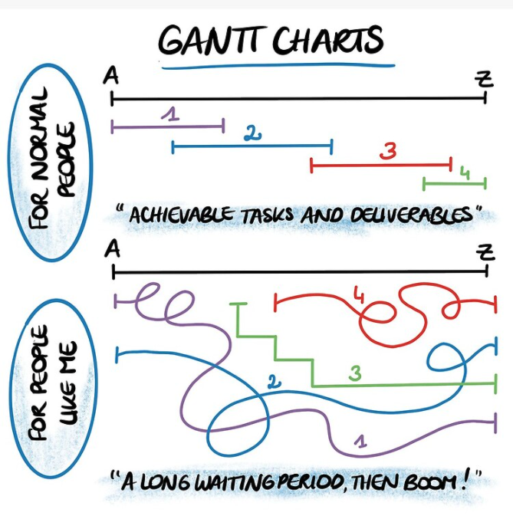
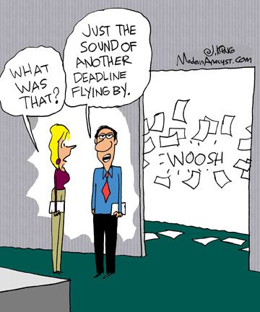
Like Progress, Process is Not Linear
Notes:
COMMUNICATE WHAT HAS HAPPENED AND ITS IMPACT

