Slide 1


Stewardship Education and Action for Nurses

Slide 2


Slide 3
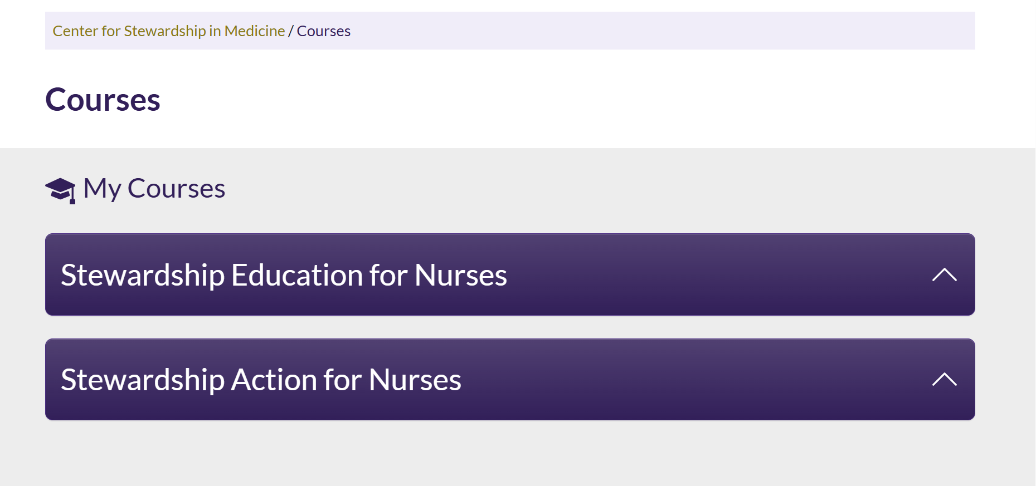

Slide 4
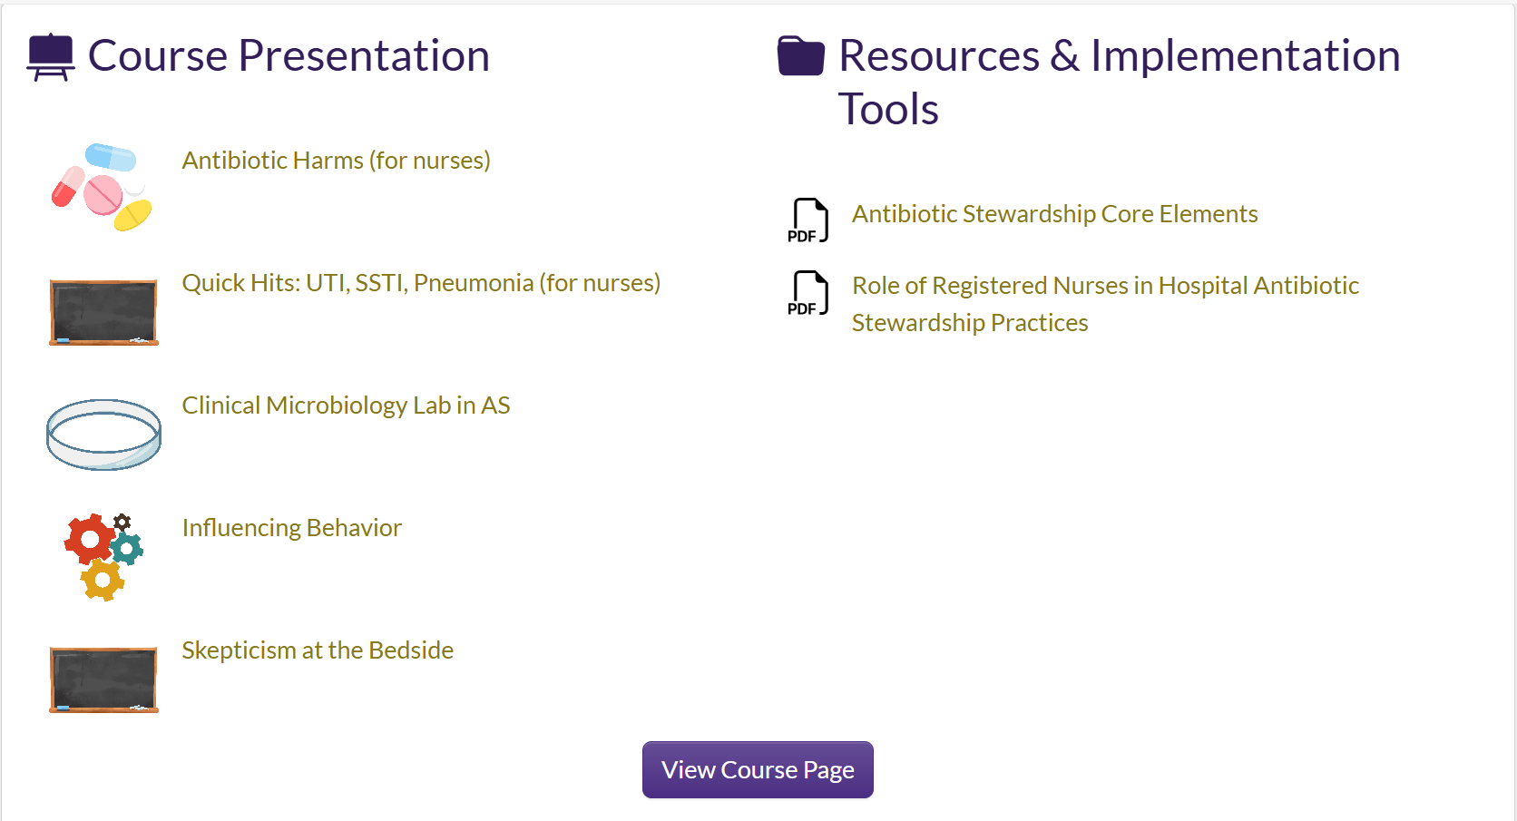
Stewardship Education for Nurses

Slide 5
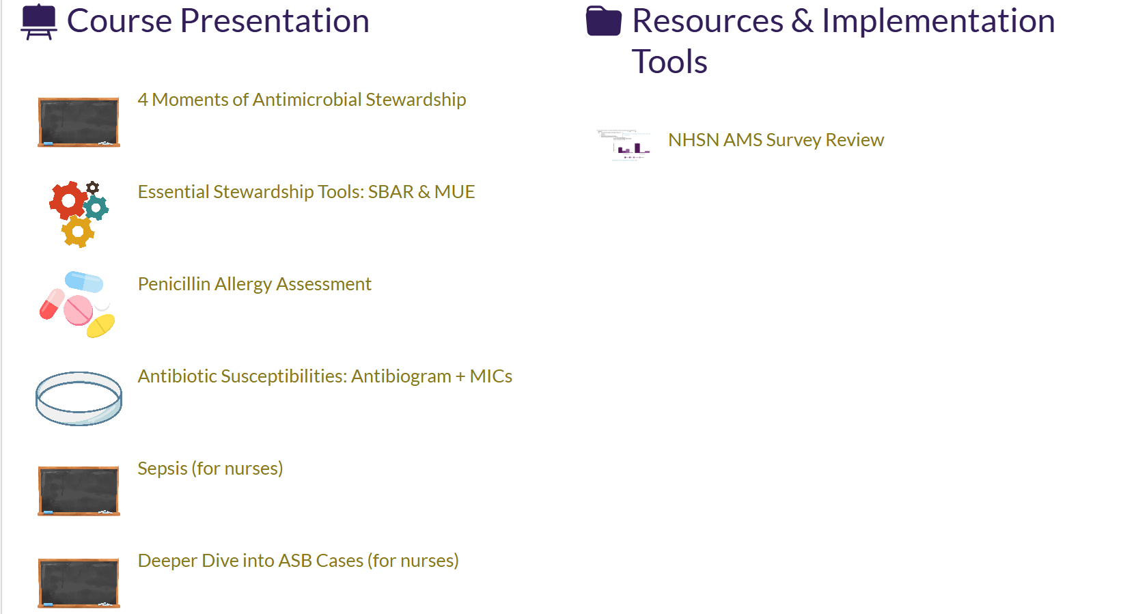
Stewardship Action for Nurses

Slide 6
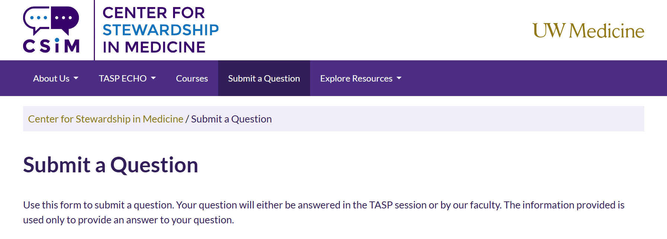
Questions?

